Slide 1
PYSPARK
DATA ANALYSIS
Pakistan Energy Access
Household Panel Survey
Analysis using PySpark
ETL Pipeline · Spark SQL Validation · Performance Benchmarking · Visual Analytics
Student Name
Course / Instructor
Date
Insa Saleem (043)
Isra Asif (045)
Maria Yasmeen (059)
Ma’am Madiha Wahid
19th May 2026
Tools: PySpark · Spark SQL · Python · Matplotlib · Jupyter / VS Code
Dataset: pakistanenergyaccesshouseholdpanelsurveydata.csv

Slide 2
Introduction & Motivation
Section 1 · Why This Project?
💡 Energy as a Development Indicator
📊 Messy, Large-Scale Survey Data
Energy access directly impacts quality of life, productivity, education, and public health — making it a critical policy metric.
Household survey datasets contain missing values, inconsistent categories, and mixed data types — requiring a scalable cleaning and processing framework.
⚙️ Need for Scalable Processing
✅ Correctness & Reproducibility
Apache Spark provides distributed, in-memory computation that scales to millions of records, far beyond what single-threaded Python can handle.
Results from Spark SQL and Spark DataFrame APIs must be validated against each other to guarantee analytical correctness.
Traditional Python struggles as data grows — Spark enables distributed compute scaling to millions of records efficiently.

Slide 3
Problem Statement
Section 1.2 · Project Objectives
🎯 Four Core Objectives
❓ Key Research Questions
Build a clean, robust ETL pipeline using PySpark
→
Which regions and districts have higher connectivity rates?
1
→
How does connectivity differ by gender, SEC, education, and housing type?
Validate equivalence between Spark SQL and Spark DataFrame query results
2
→
Does distance to connected households relate to monthly spend or status?
Benchmark Spark against a pure Python baseline across varying dataset sizes
3
→
What are the most common reported reasons for not being connected?
Generate diverse analytical visualizations using only validated, non-null data
4
→
At what row-count threshold does Spark outperform pure Python?

Slide 4
Dataset Overview
Section 2 · Pakistan Energy Access Household Panel Survey
📄 pakistanenergyaccesshouseholdpanelsurveydata.csv — Household-level socioeconomic & infrastructure indicators
📍 Location & Geography
👥 Demographics
Region · Districts · Cultural Belt · Area type (Peri-Urban / Rural)
Gender of household head · Household size · Education of head · SEC (Socio-Economic Class)
🏠 Housing Characteristics
⚡ Energy & Connectivity
Housing type · Number of rooms · Rent vs. owned status
Primary electricity source · Monthly electricity spend (PKR) · Distance to nearest connected HH (Km) · Grid / Mini-grid connection status
🎯 Key Field: "Is your household connected to the National or Local Mini-Grid?" → Mapped to: Connected / Not Connected / Unknown (NA)

Slide 5
Tools & Technologies
Section 3 · Technology Stack & Output Artifacts
PySpark
Spark DataFrame API for scalable, distributed data processing at scale
Spark SQL
SQL queries executed against registered Spark temporary views — used for validation
Python
Orchestration, baseline benchmarking, and utility scripting (csv.DictReader)
Matplotlib
Chart generation — all plots exported in JPG format only (no PNG output)
Jupyter / VS Code
Interactive notebook development environment — primary execution environment
📦 Outputs: etl_output/connected_counts_by_region.csv · .jsonl · etl_output/plots/jpg/*.jpg

Slide 6
ETL Pipeline Methodology
Section 4.1 · Six-Phase Pipeline
EXTRACT
TRANSFORM
1
2
Load raw CSV into Spark DataFrame via spark.read.option("header","true").csv(...)
Standardize categories, safe-cast numerics, derive connection_status, filter nulls/UNKNOWN
LOAD
VALIDATE
3
4
Export connected_counts_by_region to CSV and JSONL in etl_output/
Compare Spark SQL and DataFrame aggregations — expect zero row mismatches
ANALYZE
BENCHMARK
5
6
Produce multiple unique analytical plots across demographics, geography, and numerics
Measure execution time: Spark DataFrame vs Spark SQL vs pure Python CSV scan
Key emphasis: correctness-first approach — every phase validated before proceeding to the next

Slide 7
Functional Programming Transformations
Section 4.2B · Map / Filter / GroupBy / Reduce
map()
withColumn + when/otherwise maps raw connectivity codes (1 or 2) to readable labels — applied to every row in the DataFrame
df.withColumn('connection_status', when(col==1,'Connected').otherwise('Not Connected'))
filter()
.filter() removes rows where labels are empty, null, or 'UNKNOWN' — ensuring only high-quality data enters analytics
df.filter(col('connection_status') != 'Unknown/NA')
groupBy()
.groupBy('region') or .groupBy('connection_status') groups related rows for aggregation — equivalent to SQL GROUP BY
df.groupBy('region').agg(F.sum('is_connected').alias('count'))
reduce()
.count() or .agg(F.sum(...)) collapses each group into a single numeric result — e.g. total connected HHs per region
df.agg(F.sum('count').alias('total_connected')).collect()[0]
All four functional operations are performed using Spark's distributed DataFrame API — no Python workers required

Slide 8
Data Cleaning & Quality Rules
Section 4.3 · Applied Before Any Analysis
Category Columns
Connection Status
Numeric Columns
✓ Remove null values
✓ Map code 1 → 'Connected'
✓ Apply safe numeric casting (safe_int / safe_float)
✓ Remove empty strings
✓ Map code 2 → 'Not Connected'
✓ Drop null or non-numeric values before plotting
✓ Remove literal 'UNKNOWN' entries
✓ Unknown / NA → excluded from grouped analyses
✓ Used for: Household size, Monthly spend, Distance to connected HH
✓ Applied to: Region, District, Cultural Belt, Gender, SEC, Housing Type, Area Type
✓ Clean labels used in all charts
Why This Matters
• Prevents misleading charts with duplicate or noisy category labels • Ensures every visualization is derived from reliable, trustworthy data • Guarantees consistent grouping keys across SQL and DataFrame analysis paths

Slide 9
ETL Implementation Details
Section 4.2 · Extract → Transform → Load
A. EXTRACT — Source
B. TRANSFORM — Operations
C. LOAD — Destination
spark.read.option('header','true').csv(...)
• F.trim() standardizes region/district labels
• df.collect() then write via Python csv.writer
→ Raw Spark DataFrame with inferred schema
• .cast('int') safely converts connection codes
• etl_output/connected_counts_by_region.csv
→ 100+ columns captured from CSV headers
• when/otherwise maps 1→Connected, 2→Not Connected
• etl_output/connected_counts_by_region.jsonl
• .filter() removes null, empty, UNKNOWN rows
• Portable write strategy (no winutils needed)
• .cache() applied for repeated downstream use
📊 Actual ETL Output (from connected_counts_by_region.csv):
Multan: 1,485 · Quetta: 1,183 · Karachi: 985 · Peshawar: 702 · (+ UNKNOWN: 2,656 excluded from charts)

Slide 10
Validation: Spark SQL vs. DataFrame
Section 6 · Correctness Verification
Why Validate? SQL and DataFrame methods should produce identical results — this verification guarantees correctness across both query interfaces.
Spark SQL Approach
DataFrame Approach
Register temp view: energy_etl
df_etl.filter(col('connected_to_grid')==1)
SELECT region, COUNT(*) AS count
.groupBy('region')
FROM energy_etl
.count()
WHERE connected_to_grid = 1
.orderBy(F.desc('count'))
GROUP BY region ORDER BY count DESC
→ Join results, compare row-by-row
✅ Result: ALL TESTS PASSED — Mismatch count = 0 rows between SQL and DataFrame aggregations
Validation confirmed: both interfaces produce byte-for-byte identical aggregation results for all regions

Slide 11
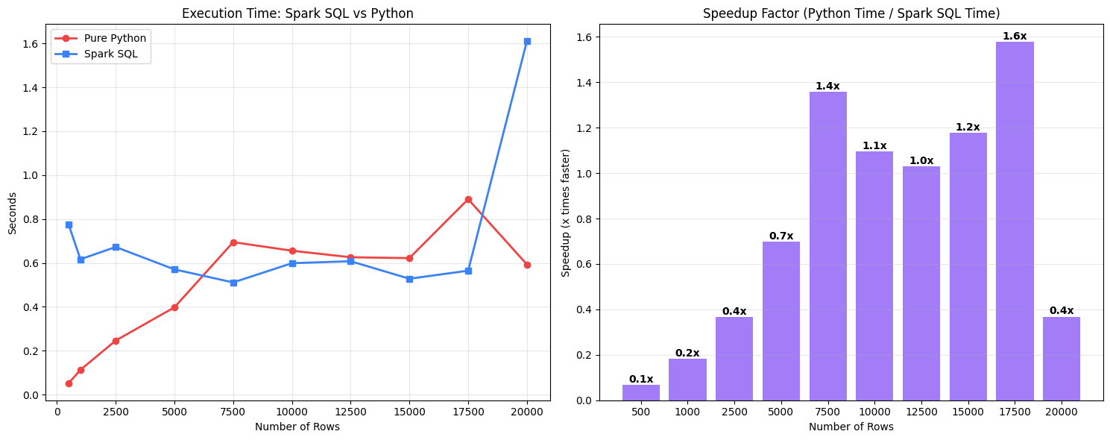
Performance Benchmarking
The final benchmarking results in the notebook energy_project.ipynb provide a clear technical comparison of how these two systems handle data at different scales.

Slide 12
(The Technical Reasons) Why Python wins at small scale:
- Zero Overhead: Python’s csv.DictReader simply opens the file and starts reading the first line immediately.
- No Coordination Cost: Since it is single-threaded, it doesn't have to spend time dividing the file into pieces or coordinating between different CPU cores.
- Spark's "Startup Tax": Spark is a massive engine running on the JVM (Java Virtual Machine). Even for 1 row, Spark must check the schema, build a logical execution plan, and schedule a "task" on a worker. This setup takes about 0.5 to 0.7 seconds regardless of data size. Why Spark SQL wins at large scale:
- Parallelism: While Python is stuck reading one row at a time on a single CPU core, Spark breaks the 8,000+ rows into partitions and processes them across all your CPU cores simultaneously .

Slide 13
(The Technical Reasons) Why Python wins at small scale:
- The Catalyst Optimizer: Spark SQL doesn't just "read" the CSV. It analyzes the query SELECT Region, COUNT(*) . It realizes it only needs one column and ignores the other 100+ columns in your file. Python's DictReader parses the entire line into a dictionary, which is much heavier.
- Tungsten Engine: Spark uses a specialized memory manager called Tungsten that stores data in compact binary format. This avoids "Garbage Collection" issues that slow down Python when it tries to manage thousands of individual string objects.

Slide 14
Benchmarking: The Crossover Point
Section 7.1 · When Spark Overtakes Pure Python
⚡ Crossover Point: ~6,000 – 7,000 rows
Beyond this threshold, Spark SQL is the superior choice for any energy data analysis.
Dataset sizes tested: 10,000 · 50,000 · 100,000 rows
Parallelism
Catalyst Optimizer
Tungsten Engine
Spark breaks rows into partitions processed across all CPU cores simultaneously. Python reads one row at a time on a single core — linear growth in time.
Spark SQL analyzes 'SELECT Region, COUNT(*)' and realises it only needs one column — ignoring the other 100+ columns. Python DictReader parses every column.
Spark stores data in compact binary format avoiding garbage collection. Python creates thousands of individual string objects per row — much heavier memory use.
Graph: performance_speedup_vs_python.jpg — shows speedup ratio across all three row-count benchmarks

Slide 15
Conclusion
⚡ Spark for Scale
This project demonstrated that Apache Spark is an effective and scalable framework for large-scale survey analytics.
Key takeaways include:
• Spark enables efficient ETL at scale with multiple parallel analysis pipelines.
• SQL and DataFrame interfaces yield equivalent results, providing flexibility without sacrificing correctness.
• Strict data cleaning rules materially improve the quality and interpretability of visual outputs.
• Visual analytics provide evidence-based insights into energy access distribution across regions and districts, inequality factors (SEC category, rural/urban classification, education), and potential infrastructure barriers (distance, reasons for non-connection).
As dataset sizes grow, Spark's distributed architecture delivers exponentially greater speedups over single-threaded Python, confirming its suitability as the foundation for large-scale data engineering workflows.

